Slide 1


micro:bit entry video tutorial
Lesson 18
micro:bit creative lesson 18 “color light”
YahBoom micro:bit creative tutorial

Slide 2
micro:bit entry video tutorial
Content
Part1
Part 2
Part3
Part 4
Part 5
Learning goals
Preparation
Handmade
Search for blocks
Combine blocks
YahBoom micro:bit module tutorial

Slide 3
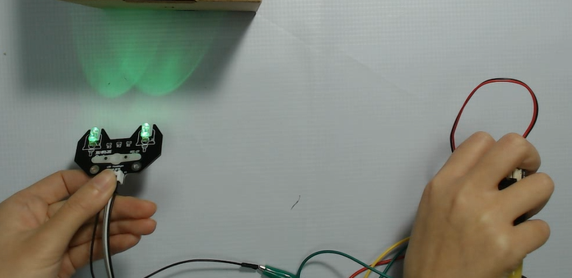
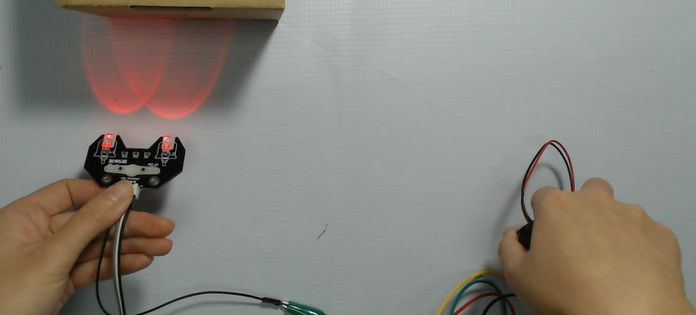
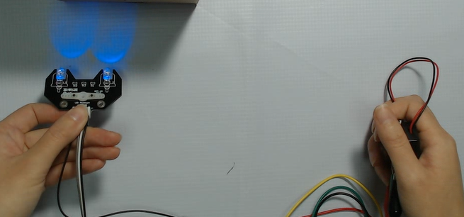
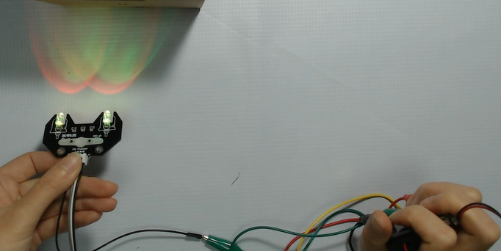
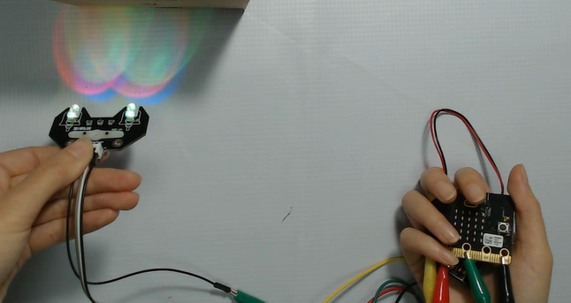
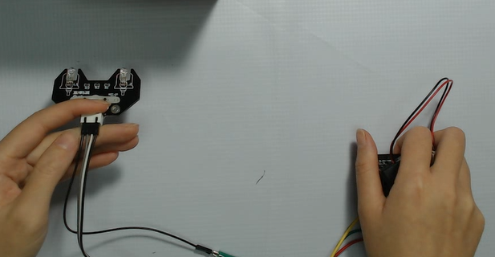
micro:bit entry video tutorial
Part 1
Learning goals
When the children have downloaded the program, we can hold micro:bit and make use of mirco:bit's gravity induction to make different gestures to control the color of the light and to turn it on and off. We can see in the effect photo that when we take the micro:bit up and the dot matrix is up, we light up the white light made up of red and green, and the different gestures can also shine out red, green, blue, and yellow.
YahBoom micro:bit creative tutorial

Slide 4
micro:bit entry video tutorial
Part 2
Hardware:
● 1 X Micro: bit Board
● 1 X Micro USB Cable
● 4 X Dupont cable
● 1 X RGB LED
Preparation
Then the micro:bit is connected to the computer through USB, and the computer will pop up a U disk and click the URL in the U disk to enter the programming interface. Input this URL https://github.com/lzty634158/yahboom_mbit_en to get the package.
YahBoom micro:bit module tutorial

Slide 5
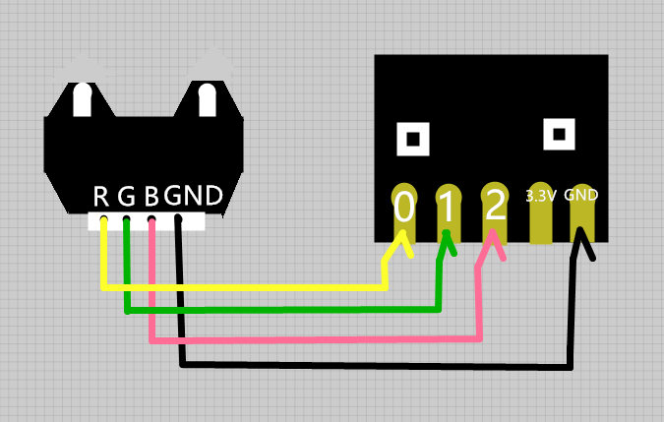
micro:bit entry video tutorial
Part 3
handmade
Connection line according to the upper drawing.
YahBoom micro:bit creative tutorial

Slide 6
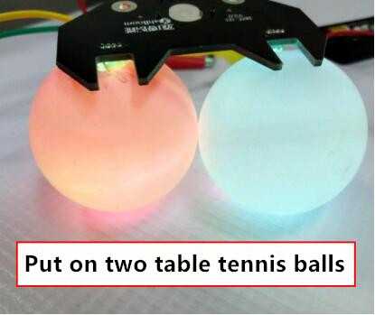
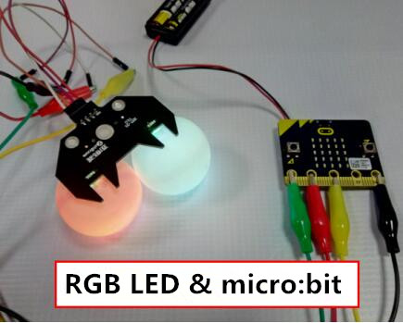
micro:bit entry video tutorial
Part 3
handmade
Or the children can also prepare two table tennis balls, and then whip the colorful lights down 90 degrees, with two table tennis table ball with two holes to hold seven color lamps, looks like the eyes of the colorful lamp, is not beautiful many?
YahBoom micro:bit creative tutorial

Slide 7
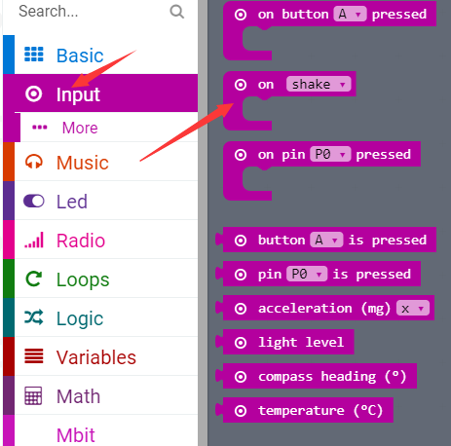
micro:bit entry video tutorial
Part 4
Search for blocks
YahBoom micro:bit creative tutorial

Slide 8
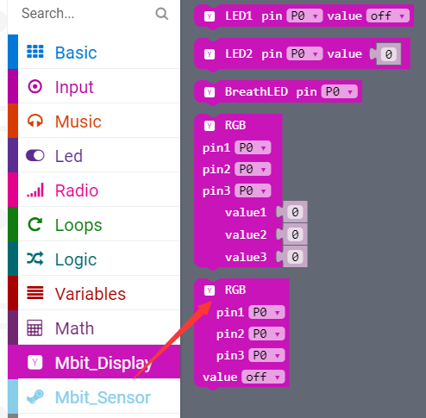
micro:bit entry video tutorial
Part 4
Search for blocks
YahBoom micro:bit creative tutorial

Slide 9
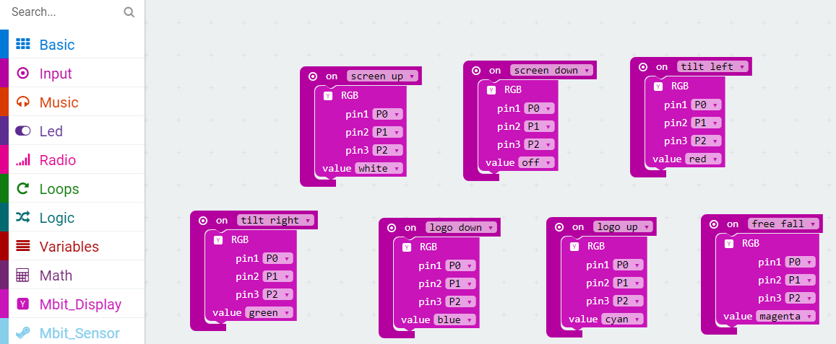
micro:bit entry video tutorial
Part 5
Combine blocks
YahBoom micro:bit creative tutorial

Slide 10
micro:bit entry video tutorial
micro:bit
project
Thanks for watching！
Powered by YahBoom
YahBoom micro:bit module tutorial

